Slide 1

Creating a School Climate to S.O.A.R.
Title IX, Mandated Reporting, Mental Health/ Suicide Prevention Training, Bullying, & SEL)
  Dawn Moreland (School Counselor)
  2025-2026

Slide 2
AGENDA
Title IX
Mandated Reporting
Mental Health Trainings
Suicide Prevention
Bullying
Social- Emotional Learning
Notes:
Required by the state to complete 6 hrs of Mental Health Trainings.
Canvas Courses
More detail to come…

Slide 3

Disclaimer
The contents of this training are very sensitive in nature.
Notes:
Not intended to offend or trigger anyone.
We all come from different backgrounds and experiences.

Slide 4

Click here for the Canvas Training Link:
https://nga.instructure.com/courses/1422

Slide 5

Mandated Reporting

Slide 6
Mandated Reporting
North Carolina law requires people and institutions to report suspected child abuse, neglect, or dependency to the local Department of Social Services (DSS):
Who must report: Anyone who has a reasonable cause to suspect abuse, neglect, or dependency
What to report: Any information about the child and what makes you suspect physical, emotional, or sexual abuse or neglect.
How to report: Call or write to the DSS/CPS in the county where the child lives
  336-641-3795 Greensboro
Liability: Reporters are immune from civil or criminal liability if they report in good faith
Notes:
Dependency: a dependent child is one whose basic needs for care and supervision are not being met by a responsible adult, and alternative arrangements are lacking, leading to a need for intervention from the state's juvenile court and Child Protective Services (CPS).

Slide 7
Types of Abuse
Physical Abuse​
Neglect
Depriving a child of living conditions which provide the minimally needed physical and emotional requirements of life, growth, and development.
Emotional Abuse​
Includes consistently blaming, belittling, or rejecting a child; consistently singling out one child for negative treatment, and persistently creating public humiliation of the child.
Sexual Abuse
- encompasses a range of acts involving unwanted sexual contact or sexual acts. Key factors are the use of force, lack of consent, and the victim's capacity to consent.
Non-accidental physical injury caused or allowed to be caused by the child’s caretaker.

Slide 8
Physical Abuse:
Physical Indicators:
Unexplained bruises and welts
Unexplained burns
Unexplained fractures
Unexplained lacerations or abrasions
Behavioral Indicators:
afraid to go home
aggressiveness, or withdrawal
behavioral extremes
frightened of parents
reports injury by parents
wary of adult contact
Non-accidental physical injury caused or allowed to be caused by the child’s caretaker.
It may occur because of over-discipline or from punishment which is improper or inappropriate for the child’s age or condition.

Slide 9
Neglect:
Physical Indicators:
• consistent hunger, poor hygiene
• inadequate or inappropriate dress
• consistent lack of supervision, especially in dangerous activities or for long periods
• unattended physical problems or needs
Behavioral Indicators:
• begging, stealing food
• extended stays at school (early arrival and late departures)
• constant fatigue, or falling asleep in class
• alcohol or drug abuse • delinquency (e.g., thefts, rule violations) • states there is no caretaker
Depriving a child of living conditions which provide the minimally needed physical and emotional requirements of life, growth, and development.
Lack of food, inadequate housing or clothing, lack of needed medical attention, abandonment, lack of supervision or guidance, unmet educational needs.
Notes:
There’s a difference between neglect and lack of resources. Still needs support but no need to report neglect

Slide 10
Emotional Abuse:
Physical Indicators:
• speech disorders
• failure to thrive
Behavioral Indicators:
• habit disorders (sucking, biting, rocking, etc.)
• conduct disorders (antisocial, destructive, etc.)
• neurotic traits (sleep disorders, inhibition of play)
• psychoneurotic reactions (hysteria, obsession, compulsion, phobias, hypochondria)
• behavior extremes: inappropriately infantile (head banging, rocking, thumb-sucking)
developmental lags (physical, emotional, intellectual)
attempted suicide
- Includes consistently blaming, belittling, or rejecting a child; consistently singling out one child for negative treatment, and persistently creating public humiliation of the child.
- Emotional abuse is the most difficult to substantiate.
Notes:
Notice there are more behavioral indicators

Slide 11
Sexual Abuse/ Sex Trafficking:
Physical indicators:
• difficulty in walking or sitting
• bruises or bleeding in external genitalia, vaginal or anal areas
• sexually-transmitted infections, especially in pre-teens
• pregnancy, especially in early adolescence
Behavioral indicators:
• unwilling to change for gym or participate in a physical education class
• torn, stained or bloody underclothing
• withdrawal, fantasy, or infantile behavior
• pain or itching in the genital area
• bizarre, sophisticated, or unusual sexual behavior or knowledge
• delinquency or running away
Sexual abuse usually is not identified through physical indicators alone.
A child’s behavior may indicate that he or she has been sexually assaulted or involved in sexual activity.
The child may confide in someone about the sexual assault or sexual activity.

Slide 12
Sex Trafficking
North Carolina defines sex trafficking as a form of human trafficking under G.S. 14-43.11.
In North Carolina, sex trafficking is defined as inducing a commercial sex act through force, fraud, or coercion, or when the person involved is under 18.
- It also includes the recruitment, harboring, transportation, provision, or obtaining of a person for labor or services through force, fraud, or coercion, leading to involuntary servitude, peonage, debt bondage, or slavery.
Important Notes:
  For sex trafficking involving minors, proof of force, fraud, or coercion is not required.
  Mistake of age or consent is not a defense in cases with minors.
  Penalties are more severe when the victim is a minor.
  Trafficking survivors can file civil lawsuits for damages.

Slide 13
Reporting Abuse and Neglect
Child Protective Services/ NCDHHS
  336-641-3795 Greensboro
  336-641-3000 High Point
    Things you will need:
      Student’s First & Last Name
      Parent’s Name
      Date of Birth
      Address
      Firsthand Details of Concern

Slide 14

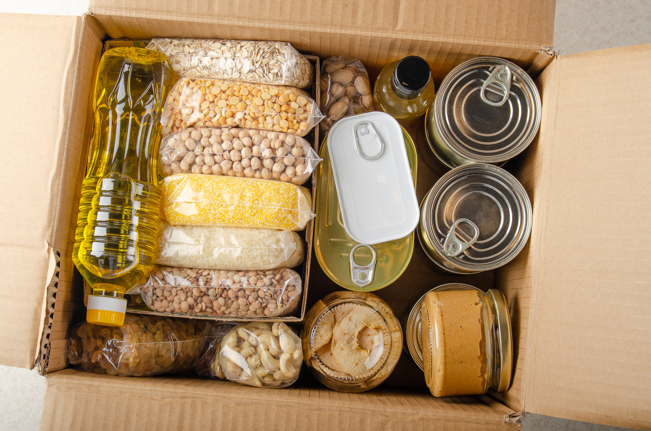

In School Resources
McKinney- Vento
Food Pantry
Clothes & Supply Closet

Slide 15

Mental Health Trainings

Slide 16
Required
School- Based
Mental Health
Trainings
Youth Mental Health
Substance Misuse
Suicide Prevention
Teenage Dating Violence
Child Sexual Abuse Prevention
Sex Trafficking Prevention
Notes:
The past couple of years we’ve been required by the state to complete 6 hrs of Mental Health Trainings.
online self-paced Canvas Course
More detail to come…

Slide 17

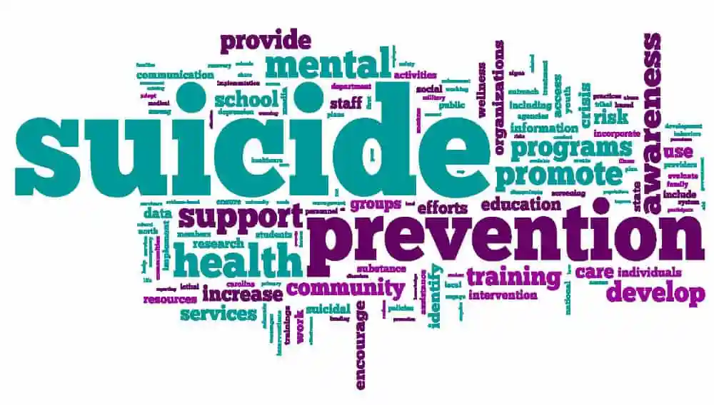

Slide 18
Suicide Prevention Facts
Did you know that:
Suicide is the 3rd leading cause of death for youth ages 10-24?
One in 11 school age students made a suicide attempt in the last 12 months?
86% of school psychologists surveyed, reported that they had counseled a student who had threatened or attempted suicide?
Prevention= Know the Warning Signs & Build Relationships
Postvention= Stay Connected

Slide 19
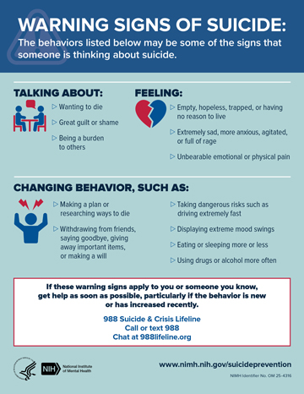

Slide 20
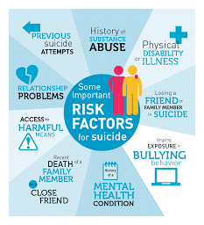
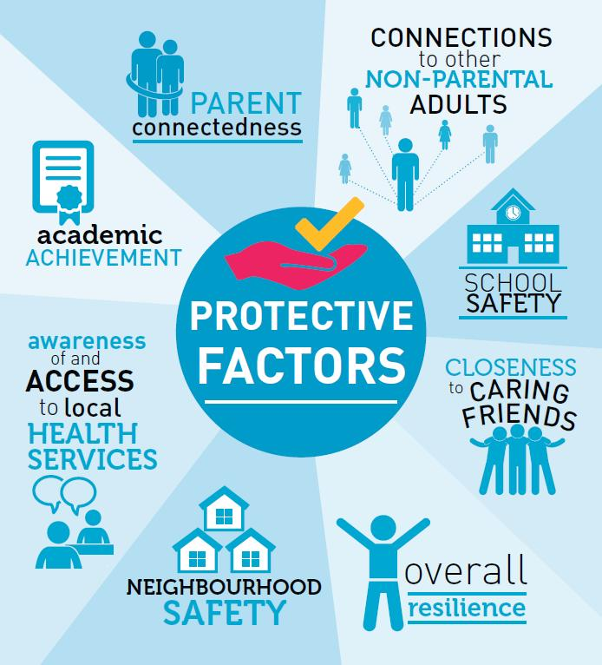
Risk & Protective Factors

Slide 21
Suicide Intervention Protocol
1. Identify
2. Connect for Screening
3. Assess
4. Connect for Care
5. Follow Up
Notes:
Let’s just say you witness a student with warning signs…
- Moreland, Carter, Admin
Identify mental health or suicidal concerns
Connect to support staff for screening
Assessment by support staff
Connect and link with appropriate care givers
Follow Up by ensuring support is in place

Slide 22
Bullying
Bullying is the use of force, coercion, hurtful teasing, comments, or threats, in order to abuse, aggressively dominate, or intimidate others. The behavior is often repeated and habitual.
Bullying, Conflict, Mean Moments
Notes:
Use Hot Topics Video if possible
Talk to your students about it
All are wrong and unacceptable, but Bullying has to be documented and addressed differently

Slide 23
Social- Emotional Learning
&
Character Education

Slide 24






SEL Morning Meetings
Build relationships, better connections and sense of community in the classroom
Helps regulate emotions and focus on learning for the day
Establishes goals, how’s everyone feeling, how you can support each other
Brief (5- 15 min.)
https://youtu.be/U6_pLkwaCeY
Notes:
(Youth, Adult and school wide plan)

Slide 25
Character Education
August/ September Self- Discipline/ Responsibility | October Respect | November Gratitude/ Appreciation
December Kindness | January Courage | February Compassion
March Integrity/ Honesty | April Perseverance | May Patience

Slide 26


Slide 27



Slide 28
THANK YOU!!!
Dawn Moreland
School Counselor
336-271-9030 Ext. 114
morelandd@nextgenerationacademy.net
Notes:
Plug
Email, Counselor Referral Form

